Slide 1
Explanatory Data Analysis
Netflix data
From Kaggle

Slide 2
Table of content
Introduction
Data Understanding
Exploratory Data Analysis
Result and Visualization
Conclusion

Slide 3

introduction
Netflix overview
Between 2010 and 2021, Netflix evolved from a U.S.-based streaming service into a global entertainment leader. During this period, it grew from 18.3 million to over 221 million subscribers, and revenue increased from $2.16 billion to $29.7 billion. This analysis explores the key trends, content strategies, and business metrics that fueled this growth.
*Data used in this analysis covers the period 2010–2021

Slide 4
Business understanding
Over the period 2010 to 2021, Netflix underwent a significant transformation from a regional streaming service to a global leader in the digital entertainment industry. To support this expansion, Netflix continues to expand and diversify its content, in terms of type of show (movies and series), genre, country of origin, and age classification.
Through the analysis of content data added during this time, the company was able to gain a strategic understanding of global market preferences, dominant genre trends, and content distribution by country, which is important for making business decisions such as investing in original production, adapting to local regulations, and developing personalization strategies for users.

Slide 5
Problem
purpose
How was the genre distribution of content on Netflix over the period 2010-2021?
How was the distribution of countries of origin of Netflix content from 2010-2021?
What is the correlation between content duration and release year?
To explore the dominance of certain genres in the Netflix portfolio from year to year.
Assessing the diversity of countries of origin of content on Netflix
Analyze whether there is a significant change in the average duration of content (movies or series) released each year.

Slide 6

Data understanding
The dataset was obtained from Kaggle with the title “Netflix Data: Cleaning, Analysis and Visualization”
Access Dataset:
https://www.kaggle.com/datasets/ariyoomotade/netflix-data-cleaning-analysis-and-visualization

Slide 7
Data dictionary
Column
Data type
Description
Show_id
Type
Title
Director
Country
Date_added
Release_year
Rating
Duration
Listed_in
Object
Object
Object
Object
Object
DateTime
Integer
Object
Object
Object
Unique ID for each show
Show type (Movie or TV Show)
Shows title
Director name
Country of origin
Date of entry to Netflix.
Original release year of the show.
Age classification (PG, TV-MA, etc.)
Duration (minutes or seasons)
Show genre

Slide 8
EXPLORATORY DATA ANALYSIS
Handling missing value and duplicated data

Slide 9
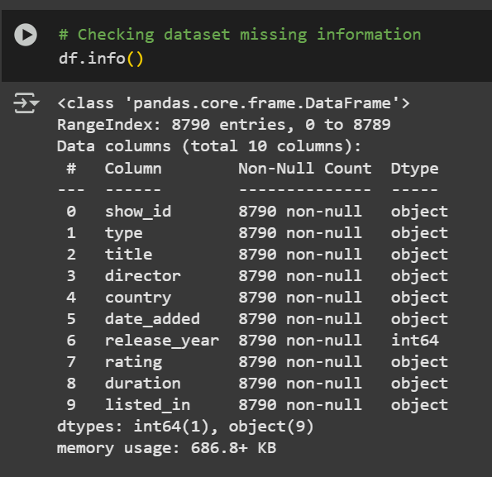
Handling missing data
At a glance, there is no empty or missing data, but if we look at it manually, the data in the 'Director' column has the value 'Not Given' or it can be said to be null.
In this missing value section, we will focus on addressing this issue

Slide 10
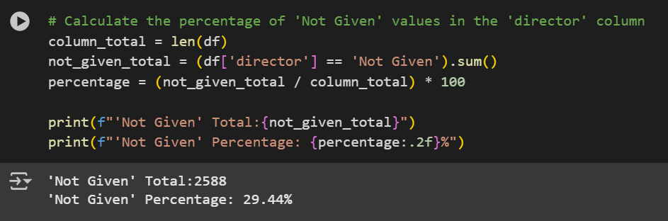
Handling missing data
For more details, if we count the number of 'Not Given' values, the total result will appears as shown in the figure.
With the total percentage exceeding 20%, the data would be considered 'too risky' if deleted in its entirety. Therefore, the 'Not Given' value will be given another label to ensure the integrity of the entire dataset.

Slide 11
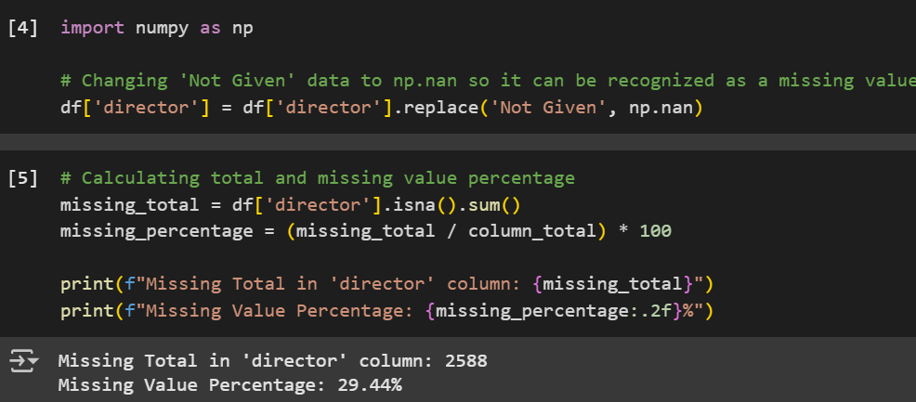
Handling missing data
Using numpy to convert data to missing data, and count the number of missing data.

Slide 12

Handling missing data
Using mode to replace 'missing value' data

Slide 13
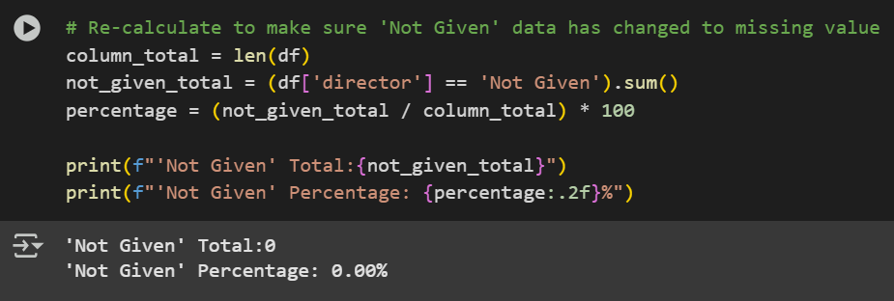
Handling missing data
Final result that missing data has been handled

Slide 14


Resolve duplicate data
Through direct code, no duplicate data was found, most likely due to different show_ids.
On the next slide, we will see the duplicates if viewed per column

Slide 15
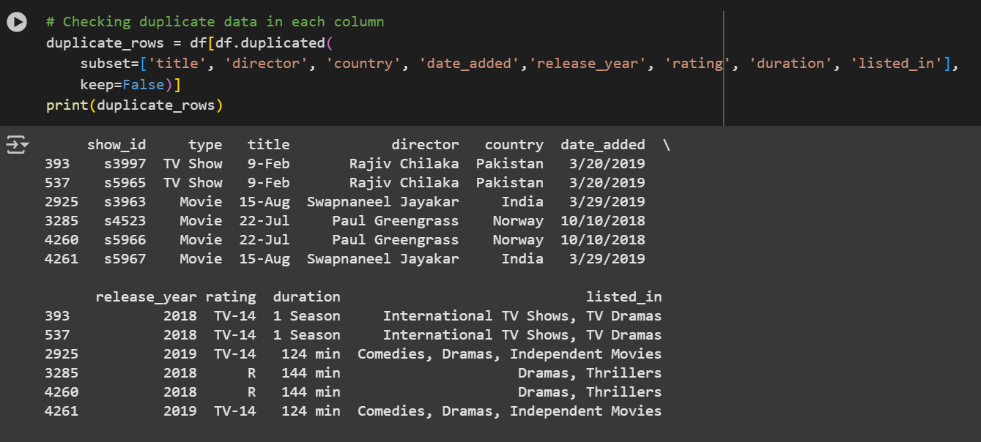
Resolve duplicate data

Slide 16
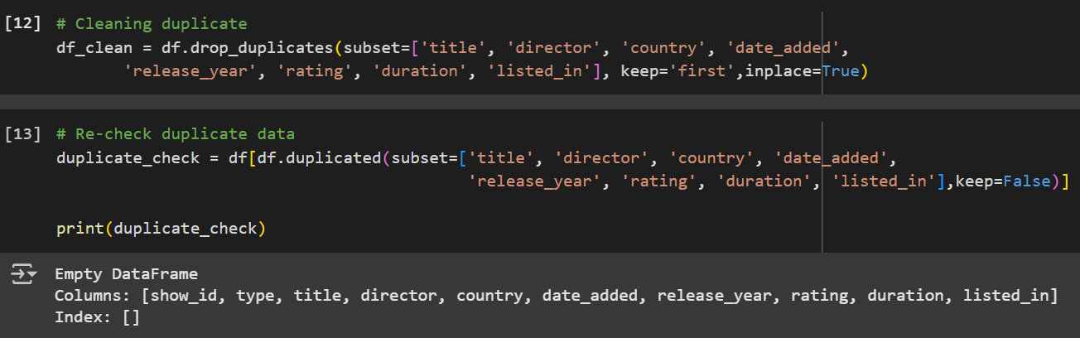
Resolve duplicate data
To remove duplicate data, the data is selected according to each column, while allowing one data from each duplicate data to remain in the overall data. And now all data are cleaned from duplicate.

Slide 17

Result and visualization
This section will answer the problem and conclusion in the form of data visualization.

Slide 18
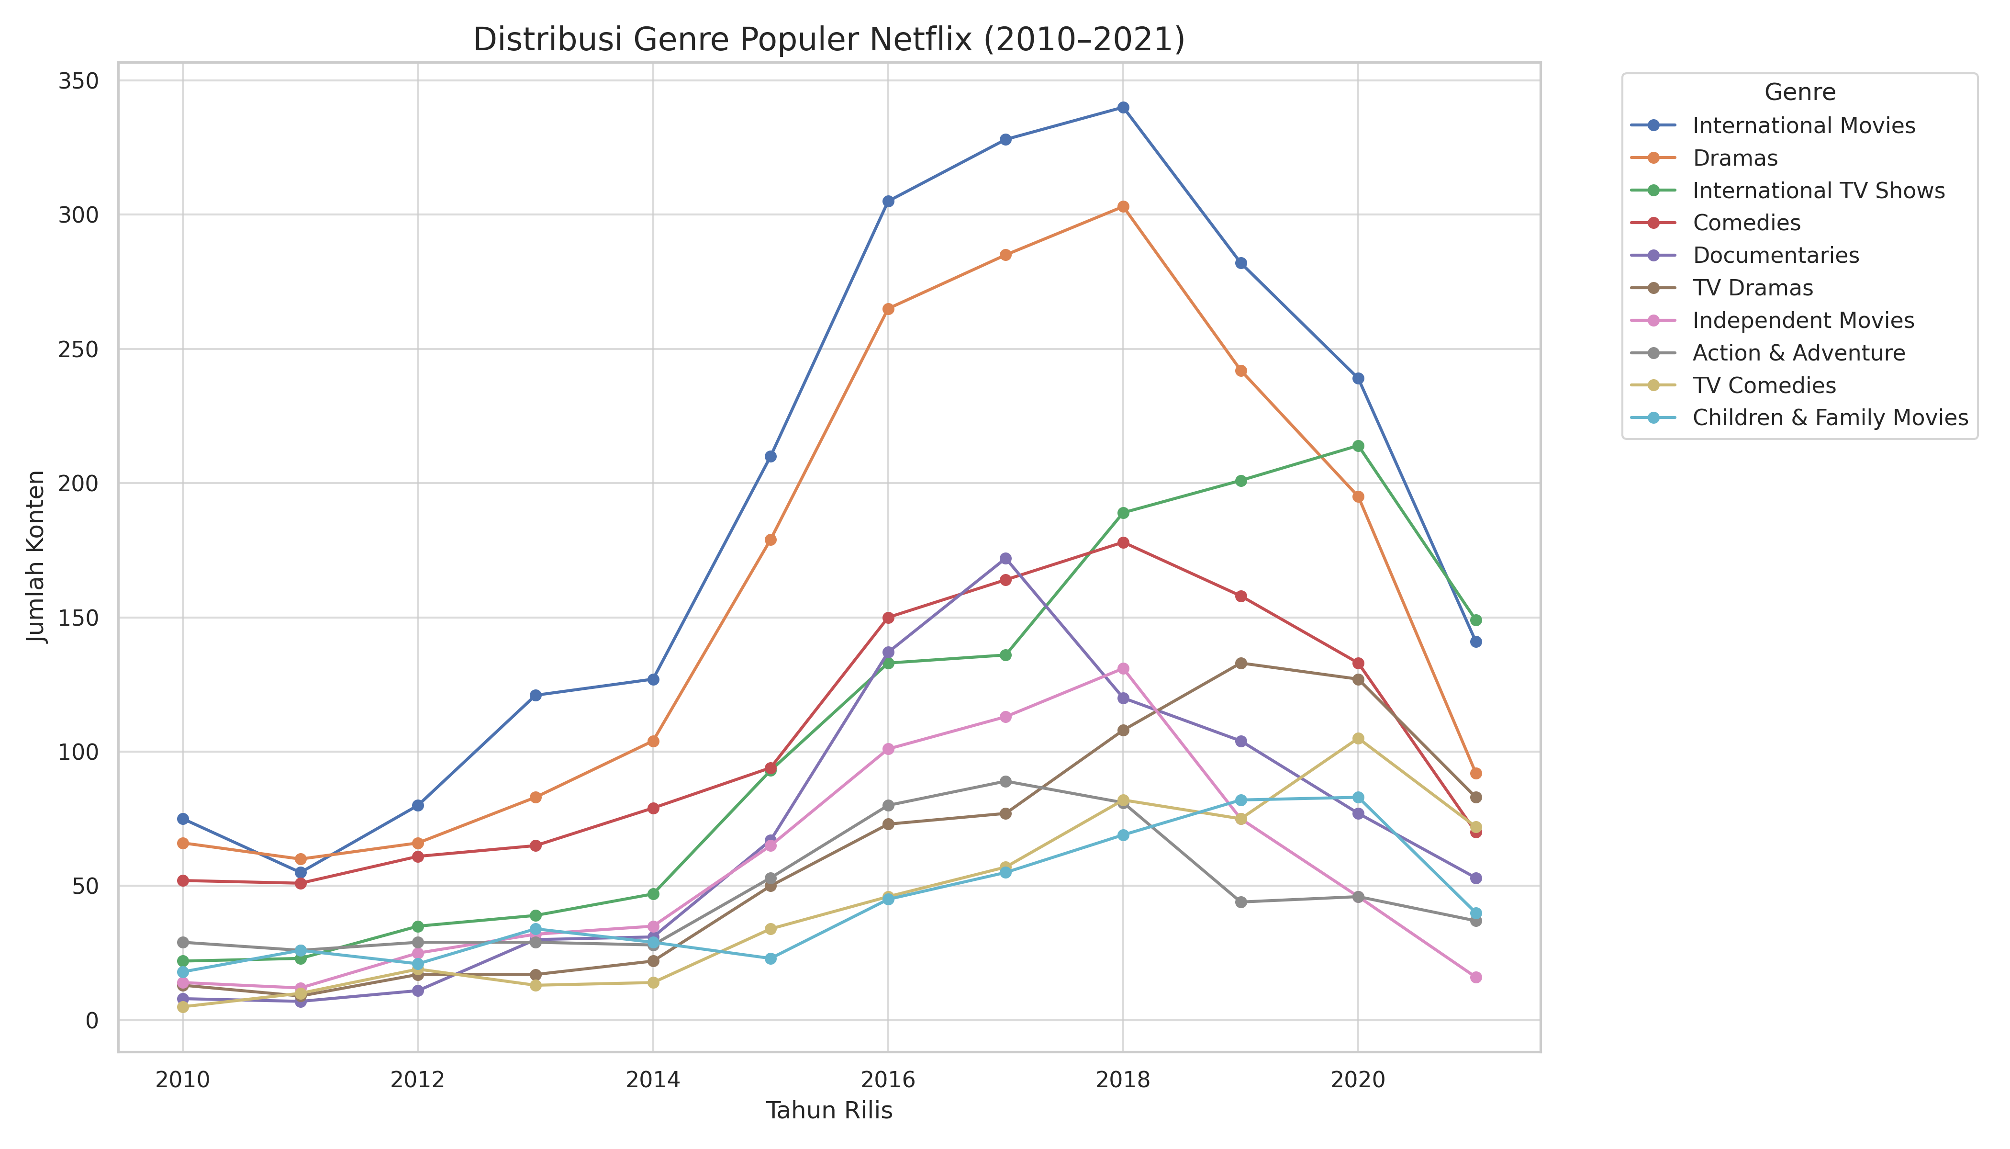
How was the genre distribution of content on Netflix over the period 2010-2021?
It can be seen from the graph that the 'International Movie' genre dominates the movies and TV shows on Netflix.
The data in the graph is the top 10 genres in the 2010-2021 time period.

Slide 19
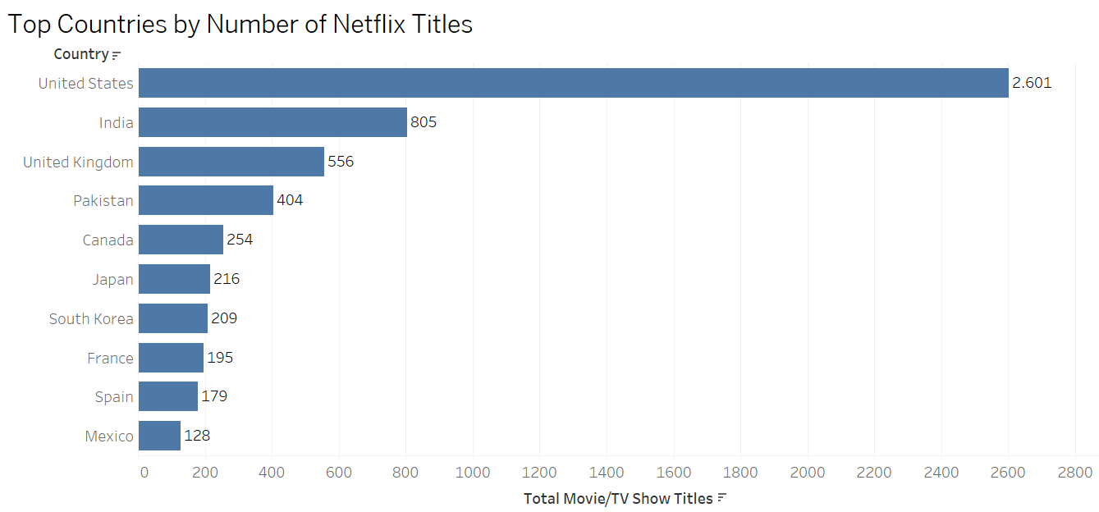
How was the distribution of countries of origin of Netflix content from 2010-2021?
The graph shows the dominance of movie or TV show makers on Netflix, but there is an uneven distribution where the United States has a longer long tail than other countries.
Countries like India, South Korea, Japan, and the UK are starting to climb the top, showing the growth of globalization in Netflix content production.

Slide 20
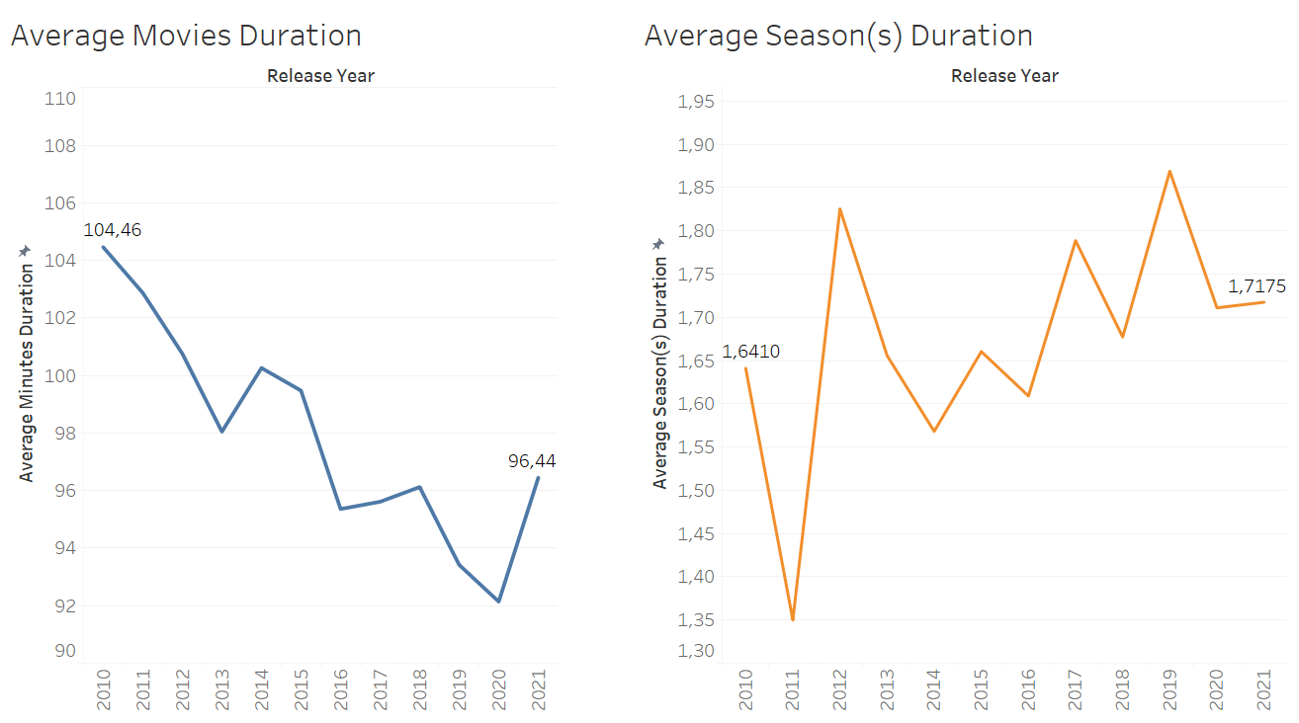
What is the correlation between content duration and release year?
From 2010-2021, the average duration of movies tended to decrease, showing a shift in consumers' movie-going habits towards shorter, quicker movies to enjoy.
On the other hand, the average number of TV Show seasons is constant, indicating that the TV Show industry maintains the number of seasons and is less impacted by changes in consumer behavior.

Slide 21
Conclusion
During the period 2010–2021, Netflix demonstrated a strategic evolution in its content library, which we can see from the 3 main issues we’ve discussed:
Genre Distribution | Country of Origin Distribution | Content Duration Trends
Netflix is consistently adding to their genre variety, with drama, comedy and documentary genres increasingly dominating, showing that Netflix continues to maximize the opportunity to reach a global audience. | While the United States remains the leading contributor of content, the growing presence of titles from India, the United Kingdom, Japan, South Korea, and other countries indicates Netflix’s push toward global content diversification and regional market penetration. | The average duration of TV shows continues to show a stable duration every year, while the average duration of movies has decreased significantly, indicating a change in consumption patterns of movie content. This suggests an adaptation to changing viewer preferences, favoring quicker, more digestible content.

Slide 22
THANK YOU
Kenly Ariesia

